Slide 1
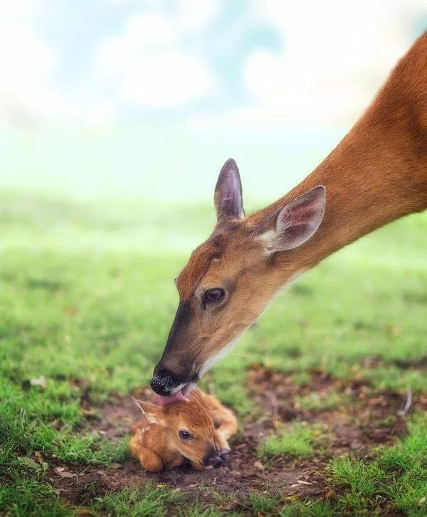
The Water of Life

Slide 2
How did Billy feed the fawn?
Cautiously/Gingerly/Carefully/Anxiously yet gently 小心地
Billy crouched/bent/stooped down/knelt down 蹲下弯腰by the weak fawn, stretching out his hands with the water in the palms.“Drink it!” he coaxed(诱哄）/signalling （示意）the fawn to drink the water.

Slide 3
What did the fawn do?
The baby fawn lifted its weak head with great efforts and eagerly lapped/licked/sipped/drank/swallowed/sucked（喝) every drop of water in his cupped hands .Thirst satisfied, the fawn looked up at little Billy, licking his moistured/moistened lips, as if a sign of gratitude.

Slide 4
Design the plot-- first sentences
I witnessed the most beautiful heart working hard to save a life.
Paragraph2
What did I do after witnessing the whole thing?
1.Before he tried to explain, I strode to him and held him tight.
2.Deeply touched by his act of kindness, I strode over and gathered my young into my arms tightly, tears of pride rolling down my cheeks and his back.
3. Never could I have imagined that my young should be blessed with such a generous heart.

Slide 5
Design the plot-- first sentences
Paragraph2
I witnessed the most beautiful heart working hard to save a life.
How did Billy react to my sudden appearance?
1.A little embarrassed but still proud, he shared the whole story with me, saying that if he didn’t offer the helping hand, the fawn would end up being thirsty to death.
2.Somewhat surprised at my suddent appearance, he appeared a little embarrassed and ran into my arms.
3.He couldn’t wait to share the whole thing with me.

Slide 6
Paragraph2
I witnessed the most beautiful heart working hard to save a life.
What miracle happened? (--rain, How to end your composition perfectly?)
1And miraculously, the tears on my cheeks turned into the long-expected rain from the sky!
2.I looked up at the sky. It was as if God, Himself, was weeping with pride. The rain that came that day was a miracle, saving our farm, like my boy saved a life.
3.It must be God’s answer to people’s call for the rain, and also a reward for Billy’s act of kindness!

Slide 7
1.Jack's test is 28 times faster (fast), 26,000 times less expensive (expensive) and over 100 times more sensitive than the current diagnostic tests.
2.It was after a close family friend died of pancreatic cancer that Jack Andraka became interested in finding a better early-detection diagnostic test.
3.Jack worked after school every day, on weekends and over holidays at Maitra's lab until he developed his test.
4. Also, keep in mind that you don't necessarily (necessary) need a giant team, billions of dollars in resources or even more than 15 years of life experience to do something amazing.
5.Diao's goal for this research is to develop (develop) wearable sensors for plants so that their health and stress levels are detected autonomously, with no need for humans to do the testing.
6.In fact, it takes most of Sunday. That's when anxiety comes creeping (creep) in and another countdown begins: 12 hours until Monday. The mounting (mount) stress of an incoming Monday can erase any joy you might get from a Sunday evening.

Slide 8
7.Most importantly, don’t leave any unsettled Friday business hanging (hang) over the weekend.
8.From digital displays that show instant price changes to advertisements linked （link) to your shopping list, you can expect the technology to become more personalized.

Slide 9
1.creep 她的双臂慢慢地搂住了他的脖子。
Her arms crept around his neck.
我渐渐地产生了一丝疑虑。
A slight feeling of suspicion crept over me.
2.mounting 上升的；增长的growing
越来越兴奋╱关注╱紧张
mounting excitement/concern/tension
3.erase 清除；消除；消灭
她试图忘却那天晚上的事。
She tried to erase the memory of that evening.
他心中所有的疑虑突然一扫而空了。
All doubts were suddenly erased from his mind.

Slide 10
1.Jack说在他高中生物课上他就想到这个方法。(无灵主语)
Jack said the solution came to him during his high school biology class.
2.你只是想尝试去把自己的想法付诸实践。
You are simply hesitate to give one of your ideas a shot. （give sth a shot 尝试）
3.翻译 To address this conflict, we should potentially help decipher(破译，辨认） how the climate change and the microenvironments are impacting the plant stress and then we are better equipped to help plants adapt to a changing environment.
（address the conflict 设法解决冲突，be equipped to do 使有能力做...，adapt to适应）
为了解决这个矛盾，我们应该尽可能地去帮助破译气候是如何变化的和微型环境是如何影响植物压力的，这样我们就更有能力去帮助植物去适应不断变化的环境。

Slide 11
It’s like the promise of a sweet hereafter following what seems like a lifetime of toil. It’s the spring in our step that gets bouncier with each passing day—until by Friday, we’re practically bumping our heads against the ceiling.
（spring 活力，朝气；bouncy 生气勃勃的，精神饱满的）
这就像一个承诺：在辛苦了一辈子之后，我们将得到一个甜蜜的未来。这就是我们脚下轻快的步伐，每过去一天，步伐就更有活力--直到周五，我们的充满活力的步伐都能够让我们的头触碰到天花板。
Spring
1名词：） 她迈着轻快的步伐向前走去。
She walked along with a spring in her step.
动词：to appear or come somewhere suddenly 突然出现（或来到）
她眼里一下子涌出了泪水。
Tears sprang to her eyes.

Slide 12
cast ：
But why should Monday cast such a long and fearful shadow on our lives?
1 向…投以（视线、笑容等）
她向他微笑以示欢迎。
She cast a welcoming smile to him.
2 投射（光、影子等）
橘红色的夕阳辉映着群山。
The setting sun cast an orange glow over the mountains.
这个坏消息给事件的进程蒙上了一层阴影。
The sad news cast a shadow over the proceedings (= made people feel unhappy).

Slide 13
para 1:
“Do you remember a cold and hungry girl who once visited this place when you worked?”
Para2:
“So you started your own business?” Old Jack mumbld after a long silence.

